Slide 1
MATRIX MULTIPLICATION USING BRAM

Slide 2
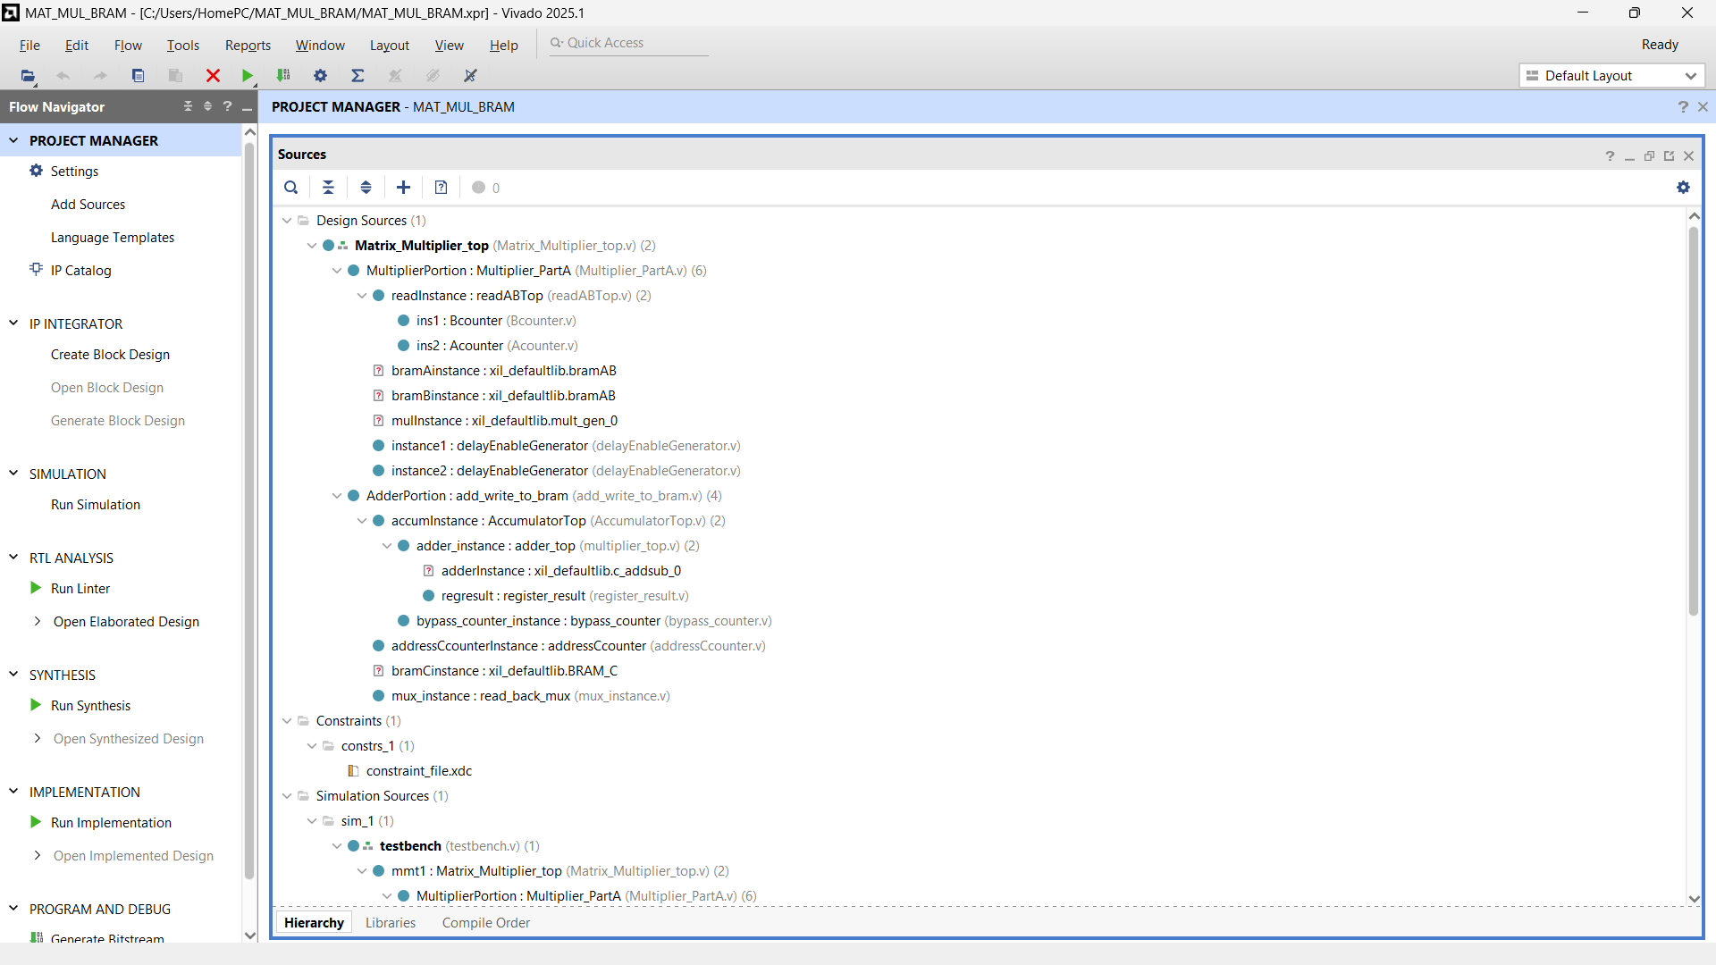
Add all required files

Slide 3
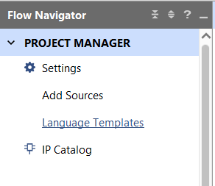
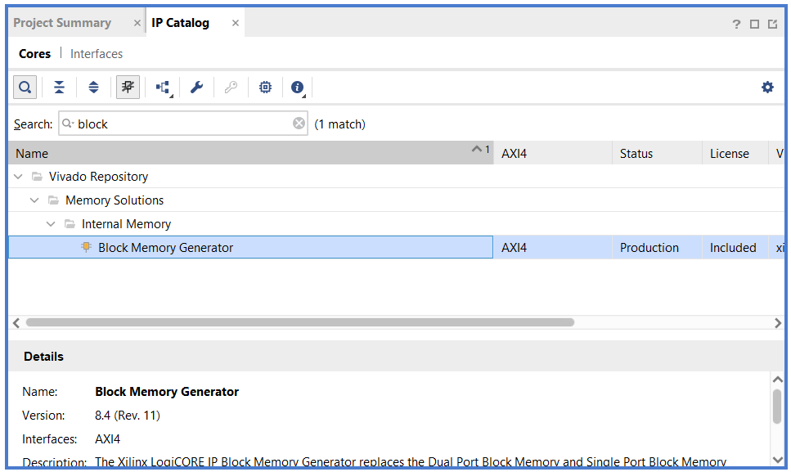
Press IP Catalog and search Block Memory Generator

Slide 4
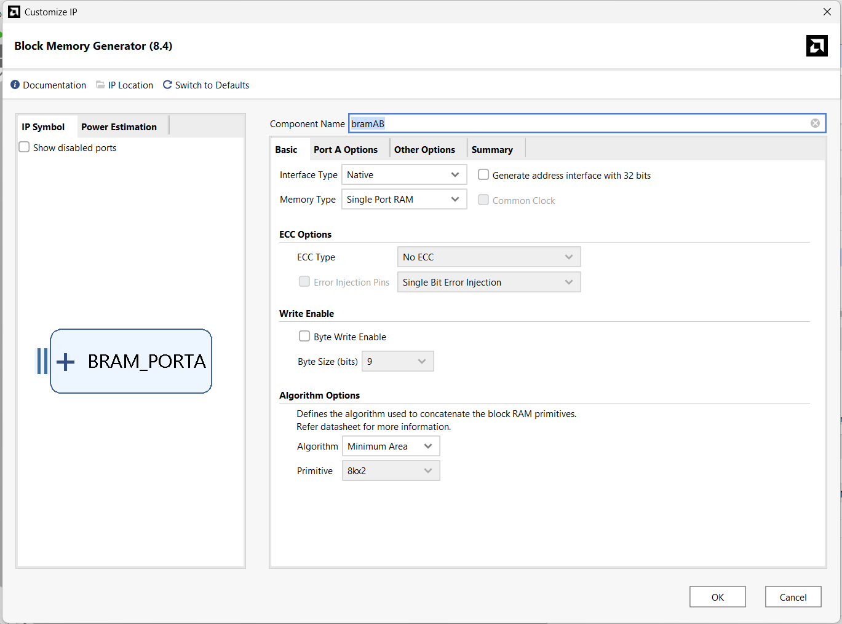
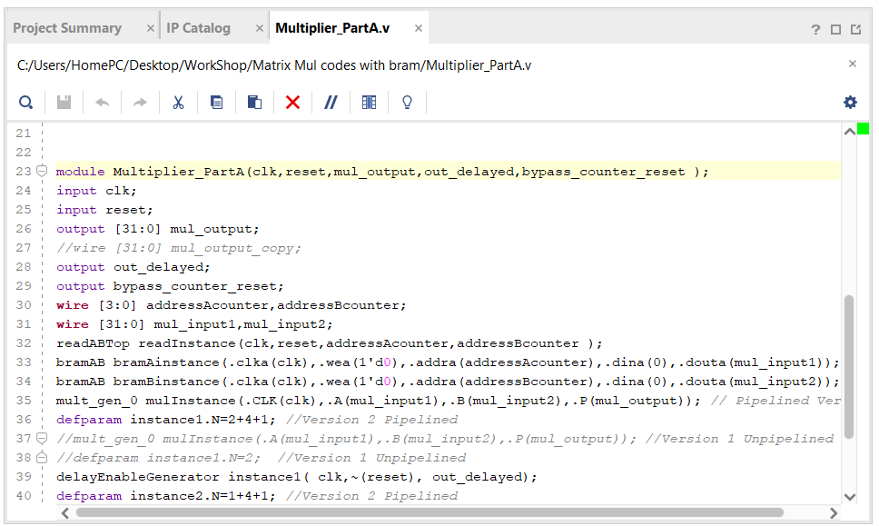
Remember the name of the component has to be same as what is used in the Verilog code of multiplier portion of the code which is bramAB

Slide 5
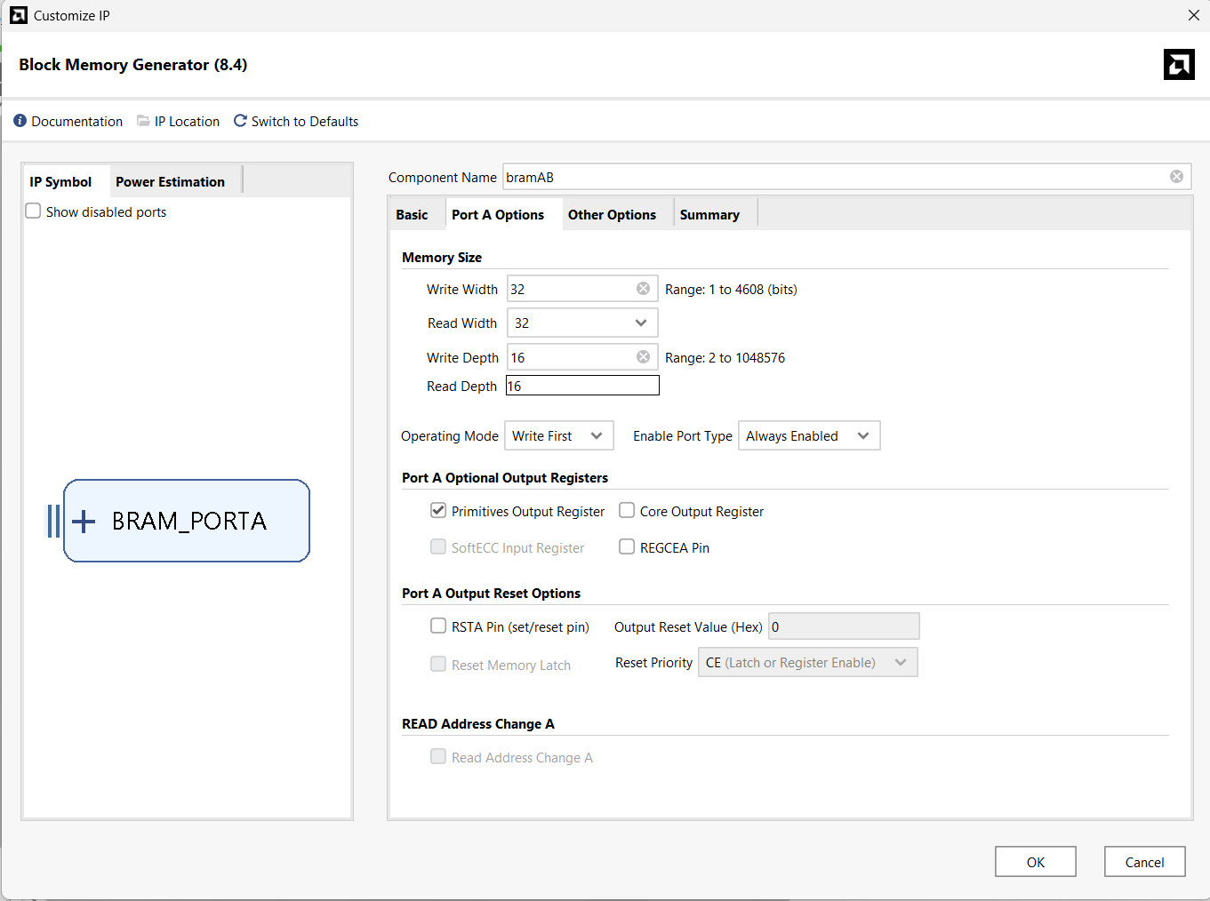
In Port A options change write width to 32 bits and change enable port type to always enable

Slide 6
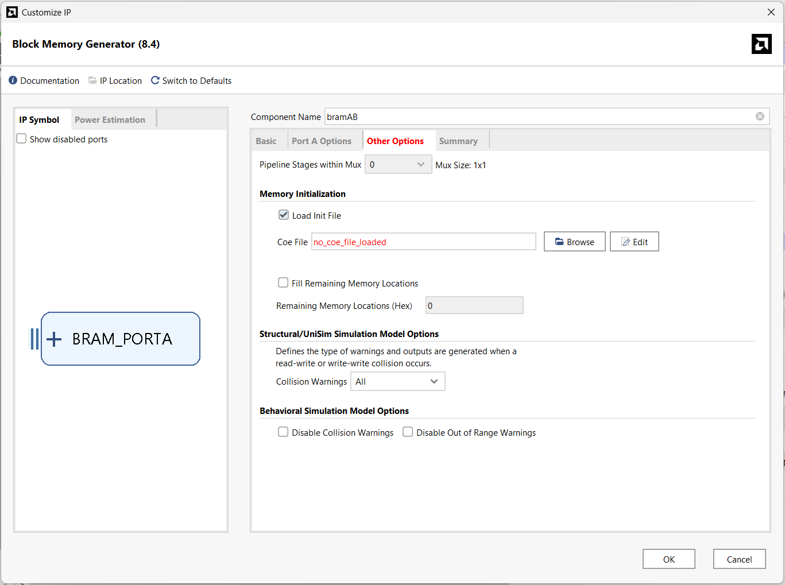
In other options, enable load init files as bram A and B shd have the data that’s the matrix with in them.

Slide 7
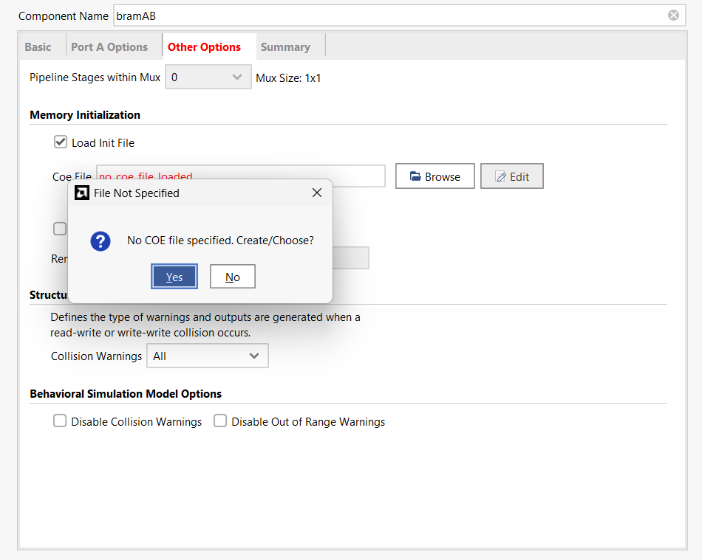
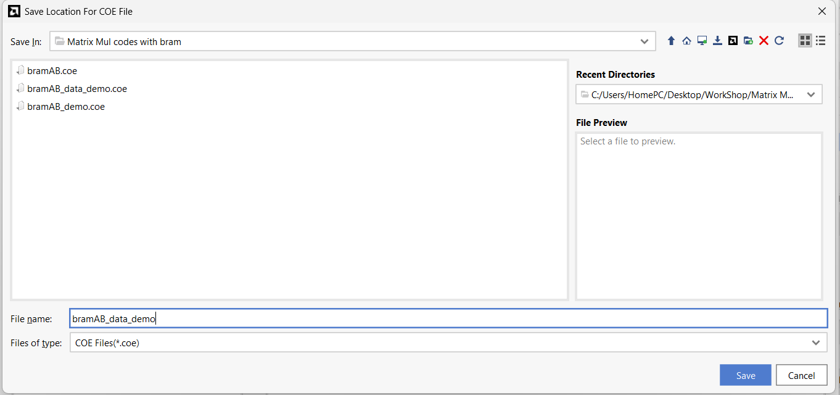
Just save the file as anything you like
Since we don’t have that file click on edit and then yes

Slide 8
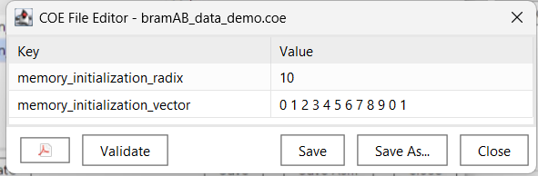
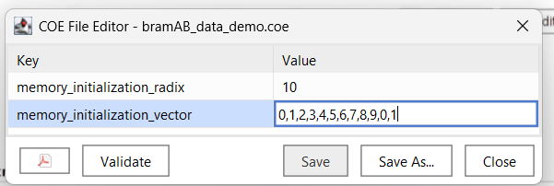
The values you give to the matrix as the matrix is 3x3 give atleast 9 values whatever after 9 is unused and then just save it and close it

Slide 9
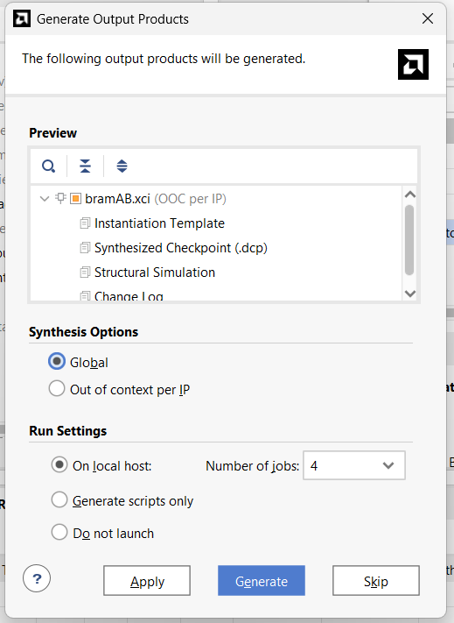
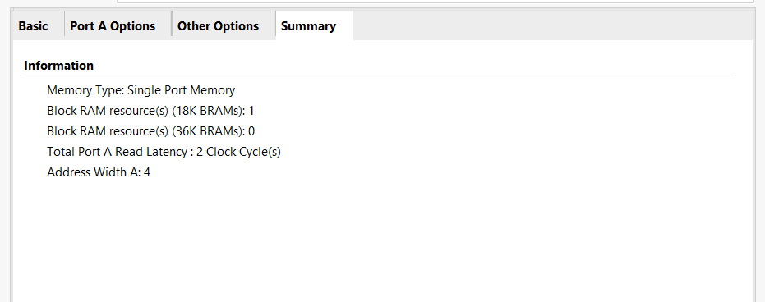
This is the summary where we can understand the latency and bram resources and press ok
Click on global and then generate
This will synthesis the design for you and add it to the design

Slide 10
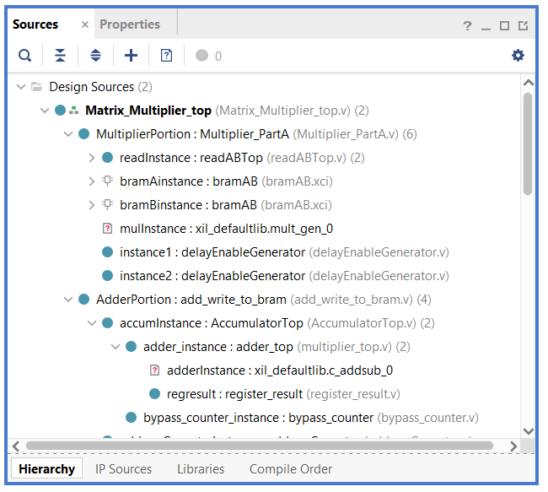
Now you can see the icon next to bram A and B indicating its not absent now same way add the multiplier also

Slide 11
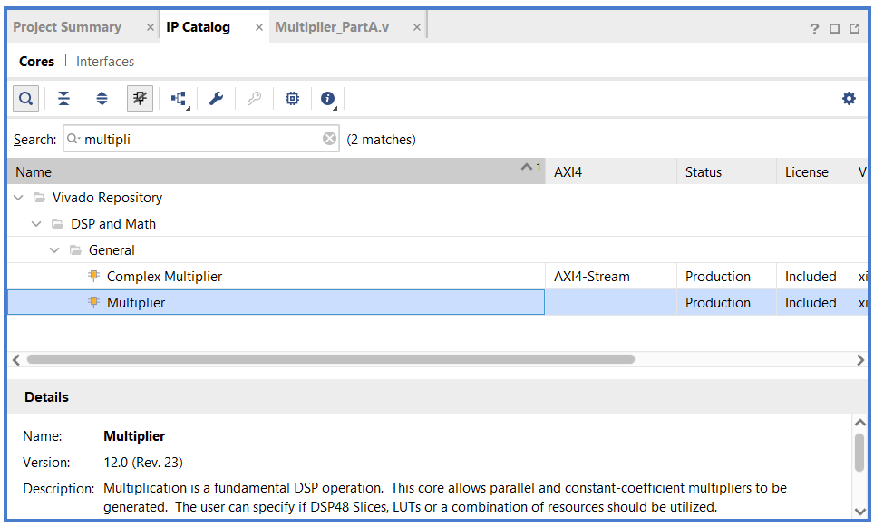
Search for multiplier in ip catalog and double click it

Slide 12
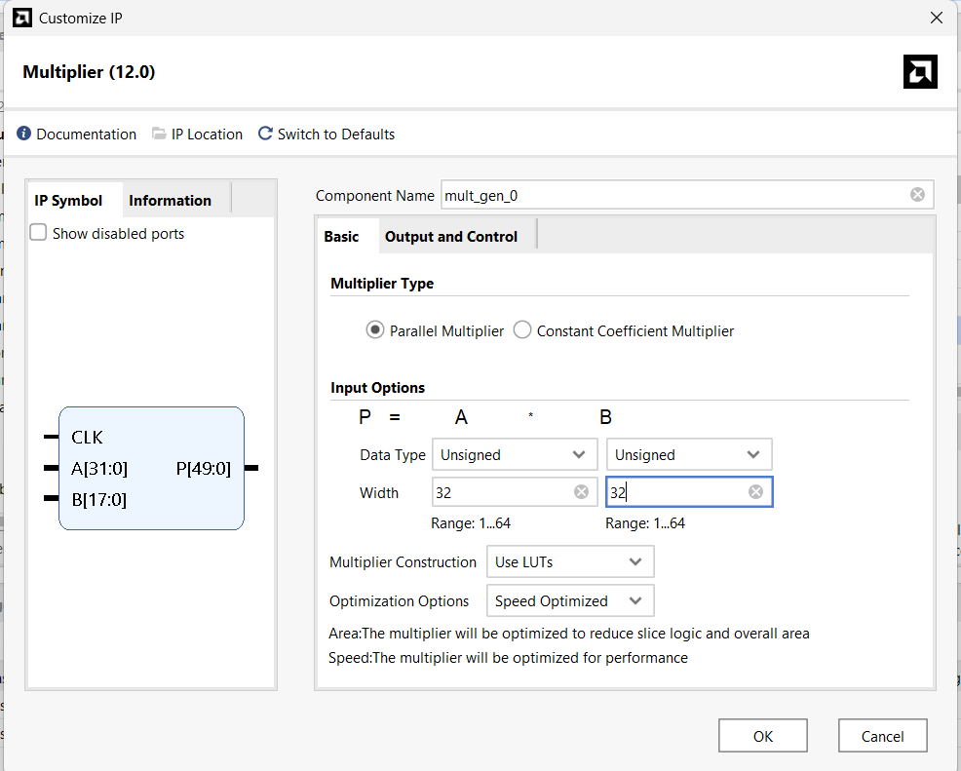
Data type :- unsigned wdith = 32 bits

Slide 13
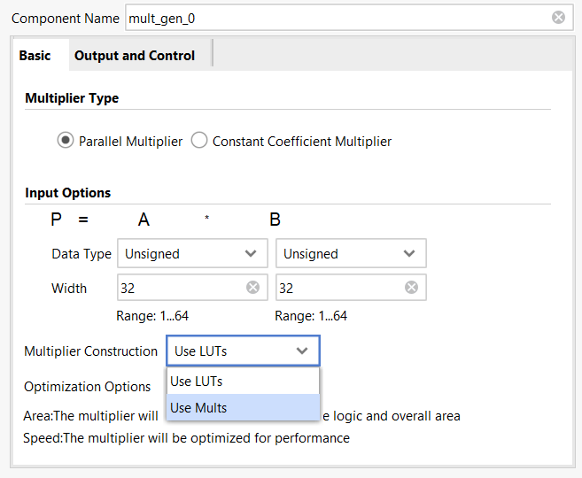
Multipliers can either be implemented using LUTs or DSP Slices which are nothing but hardware blocks that are optimized for this purpose or you can simply use LUTs let us use DSP slices for this example either way it doesn’t change the functionality

Slide 14
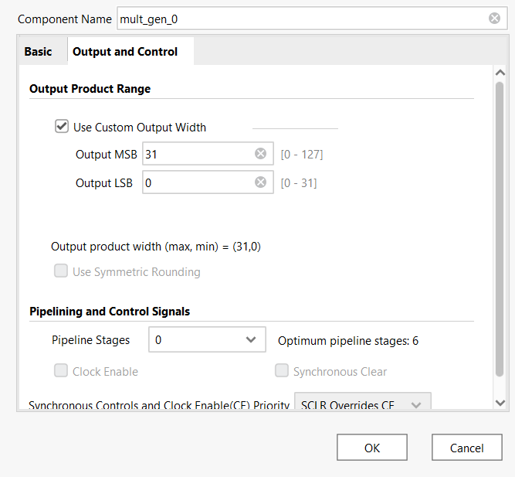
In output and controls as o/p shd also be 32 bits. Press use custom o/p width and then make it 31 down to 0 we want pipeline stages to begin with 0 and you can see the clk will vanish as this is combinational logic not a sequential logic and press ok

Slide 15
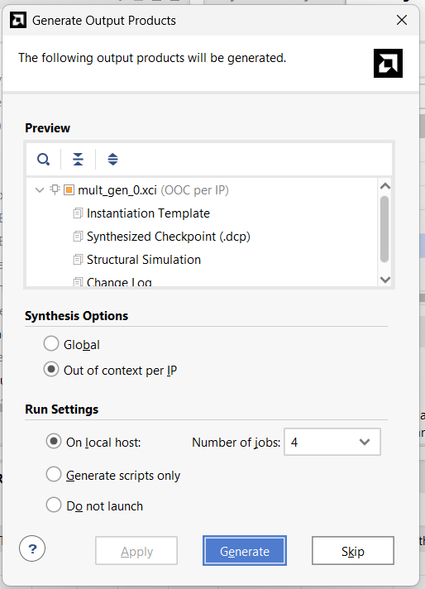
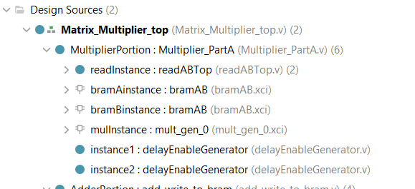
Global and generate now you can see in files that even multiplier has also got that icon

Slide 16
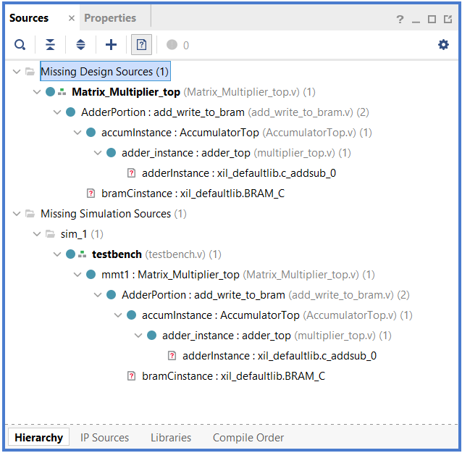
To see missing files just press on that icon and expand it you will get to see all the missing files as we can see adder is missing now the same way lets create an adder instance from ip catalog

Slide 17
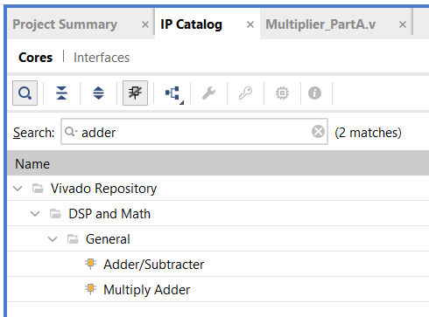
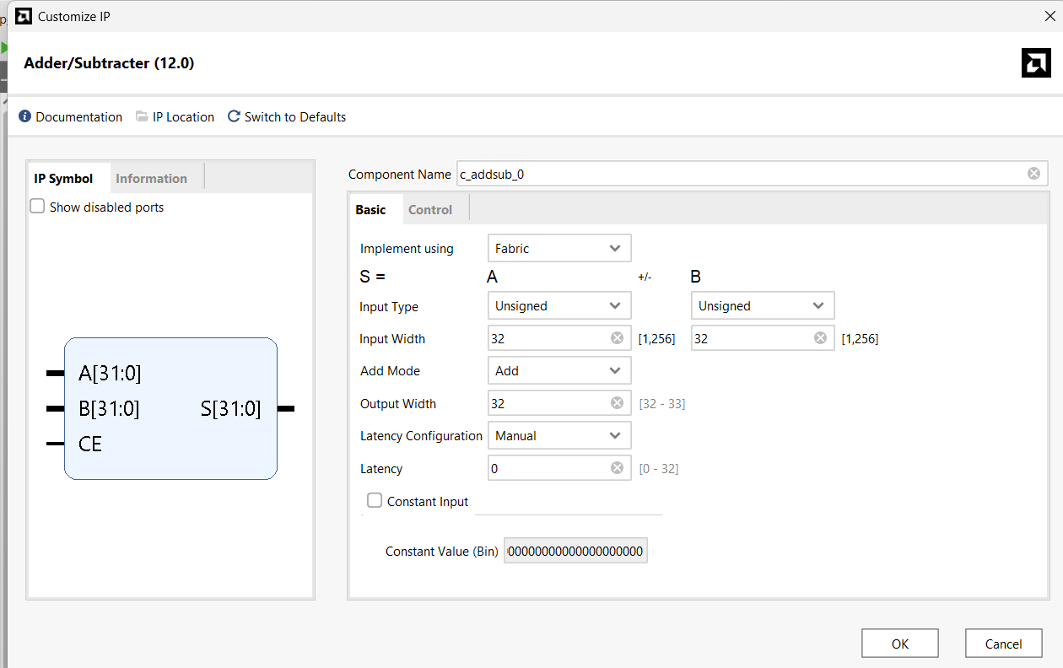
Make all the inputs unsigned and width 32 bit and latency to be 0 as we need it to be combinational block

Slide 18
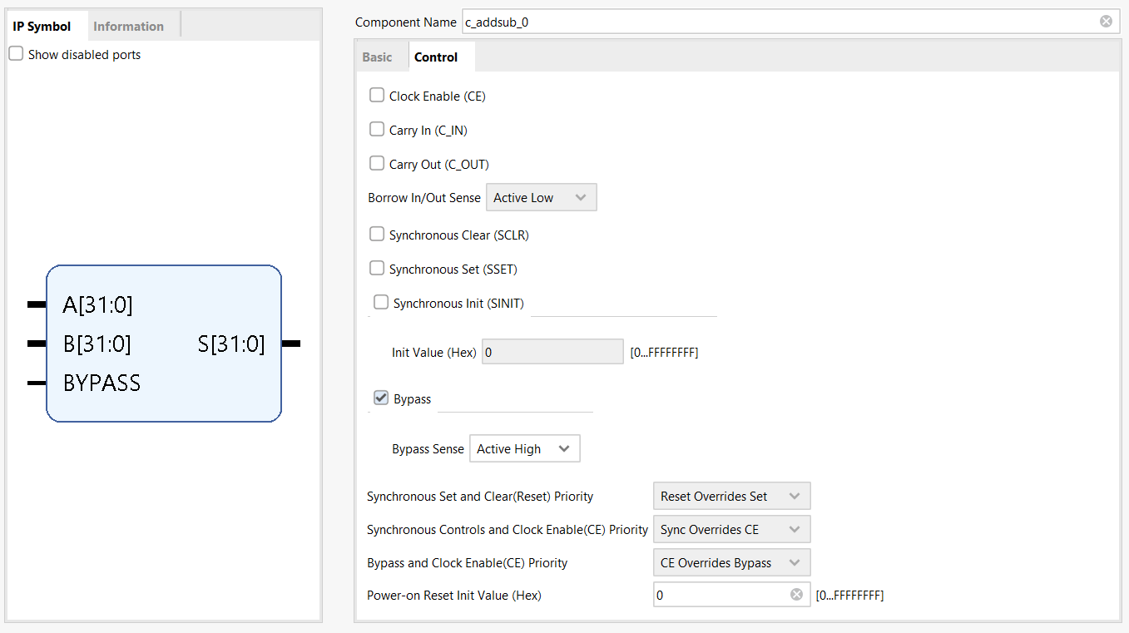
In control we don’t need clock so disable that and for the purposes of this implementation there is a need to bypass the adder on certain cycles. Press ok and Generate

Slide 19
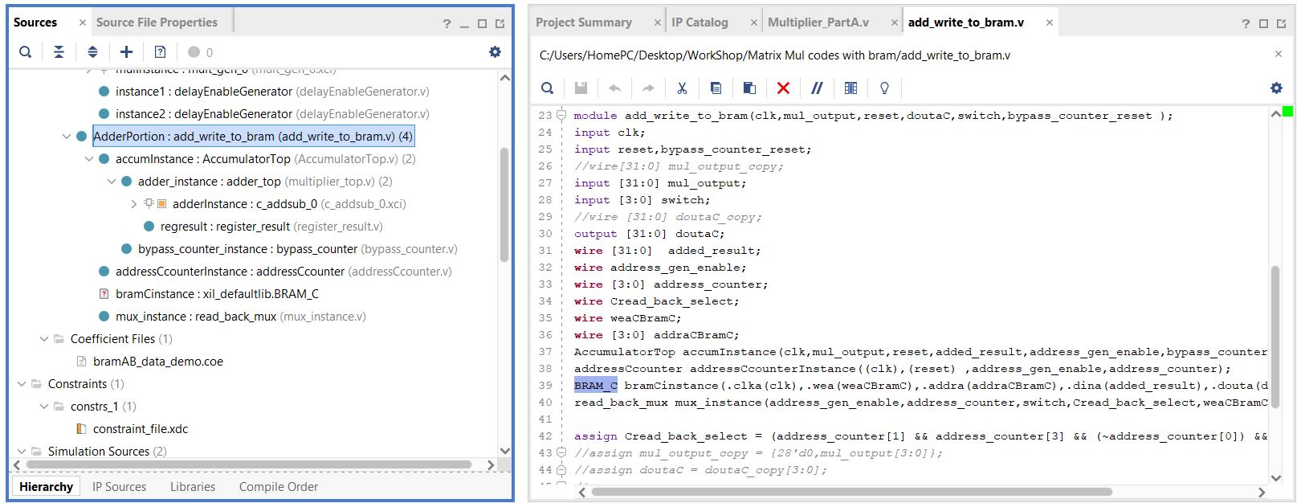
Now to create instance for BramC we shd name it as same as it is instantiated in the parent file which is adder file same way search block memory in ip catalog and change the instance as BRAM_C

Slide 20
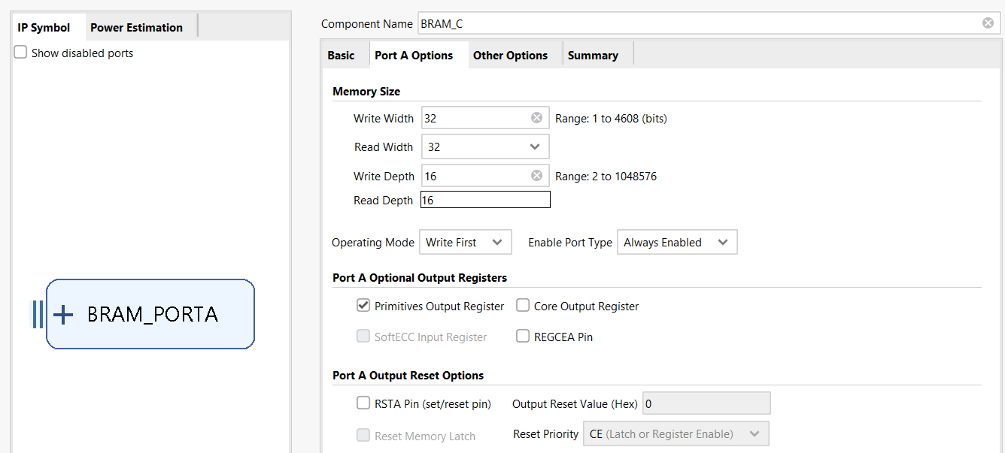
Change write width to 32 and change enable port to always enabled

Slide 21
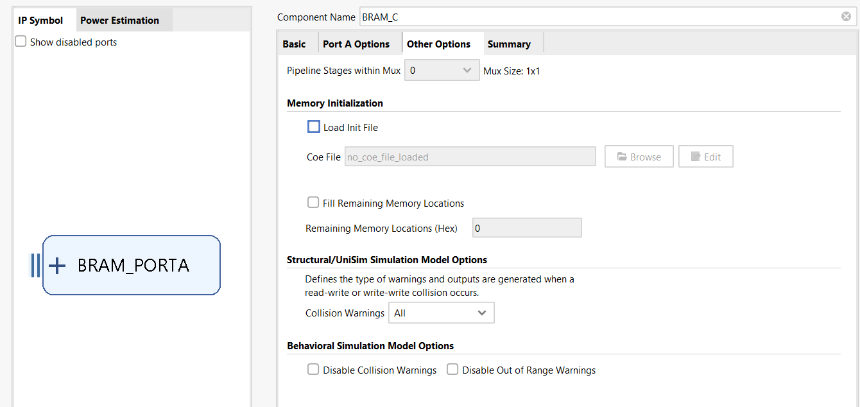
In other options we don’t need to add any file for it as we are using this bramC to write our output then press ok and global and generate

Slide 22
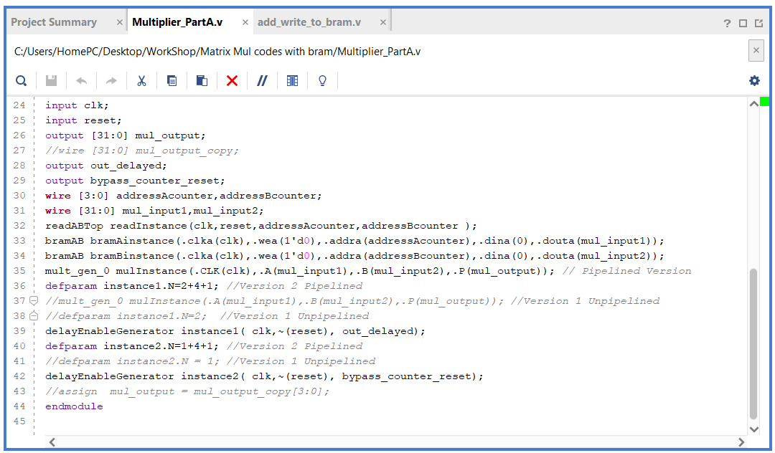
So first time when we run we have just created a multiplier with no pipelining so comment all the lines which have written for pipelined and uncomment the lines which is written for unpipelined then save the file
Now check your constraint file if all the pins are instantiated and after that the code which is given is used for both the pipelined and unpipelined versions

Slide 23
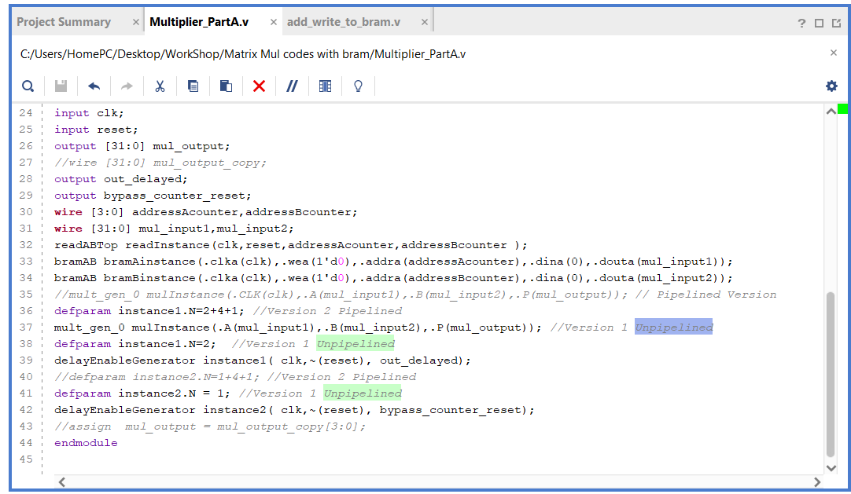
Once you have done this is how it will look and then now press run simulation

Slide 24
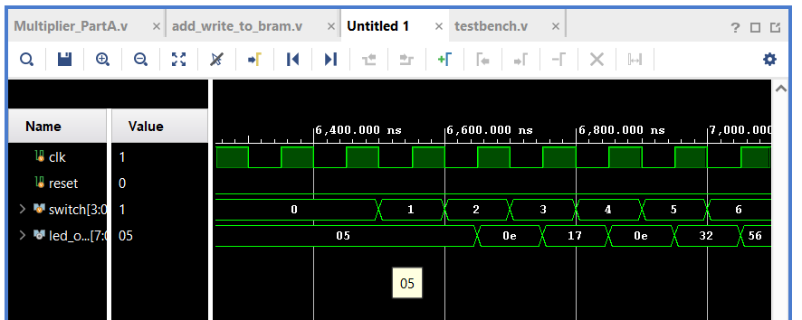
This is the waveform you get after simulating we are reading the values from the switches and whatever address we give that address is been read that Is matrix C on to the LEDs now RUN SYNTHESIS

Slide 25
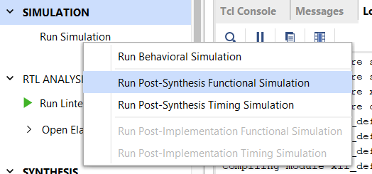
After you run synthesis check and run post synthesis simulation and confirm that the generated has the same netlist has the same functionality as you expect and check the waveform

Slide 26
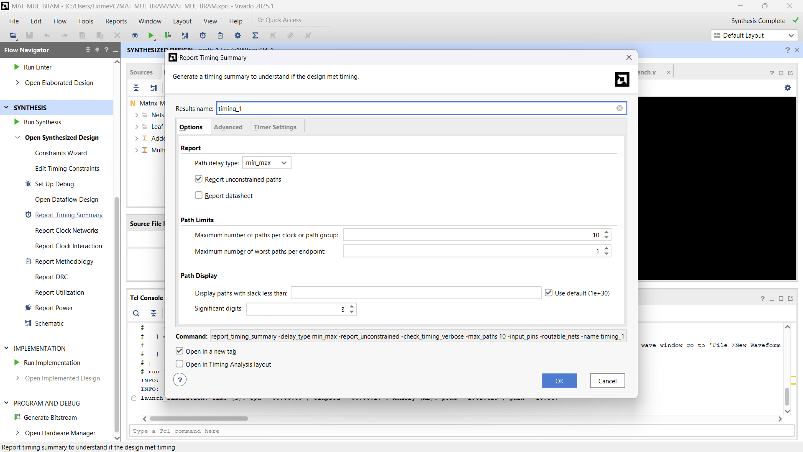
To check timing of the design press report timing summary and press ok

Slide 27
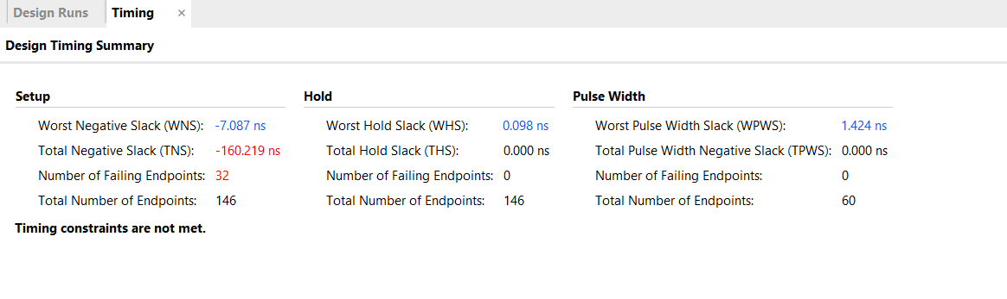
As this is unpipelined version of the code we know for a fact that 10ns is not sufficient we have –ve WNS which means that its not able to finish all the operations within the 10ns period mentioned

Slide 28
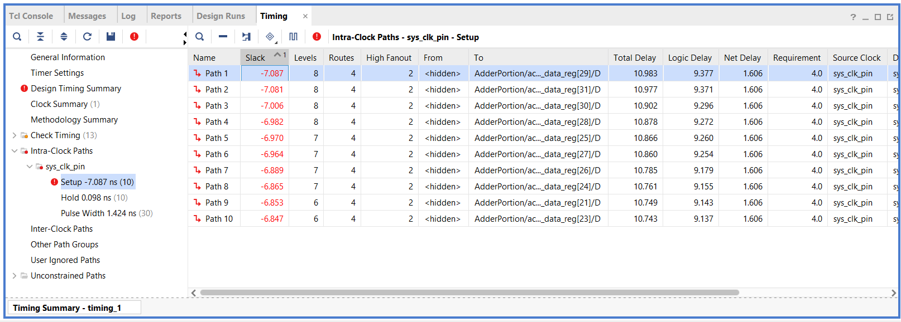
To see which path is not able to complete just press on the WNS here is -7ns this is what you get and to see the schematic of particular path select the path and just click on the highlighted icon

Slide 29
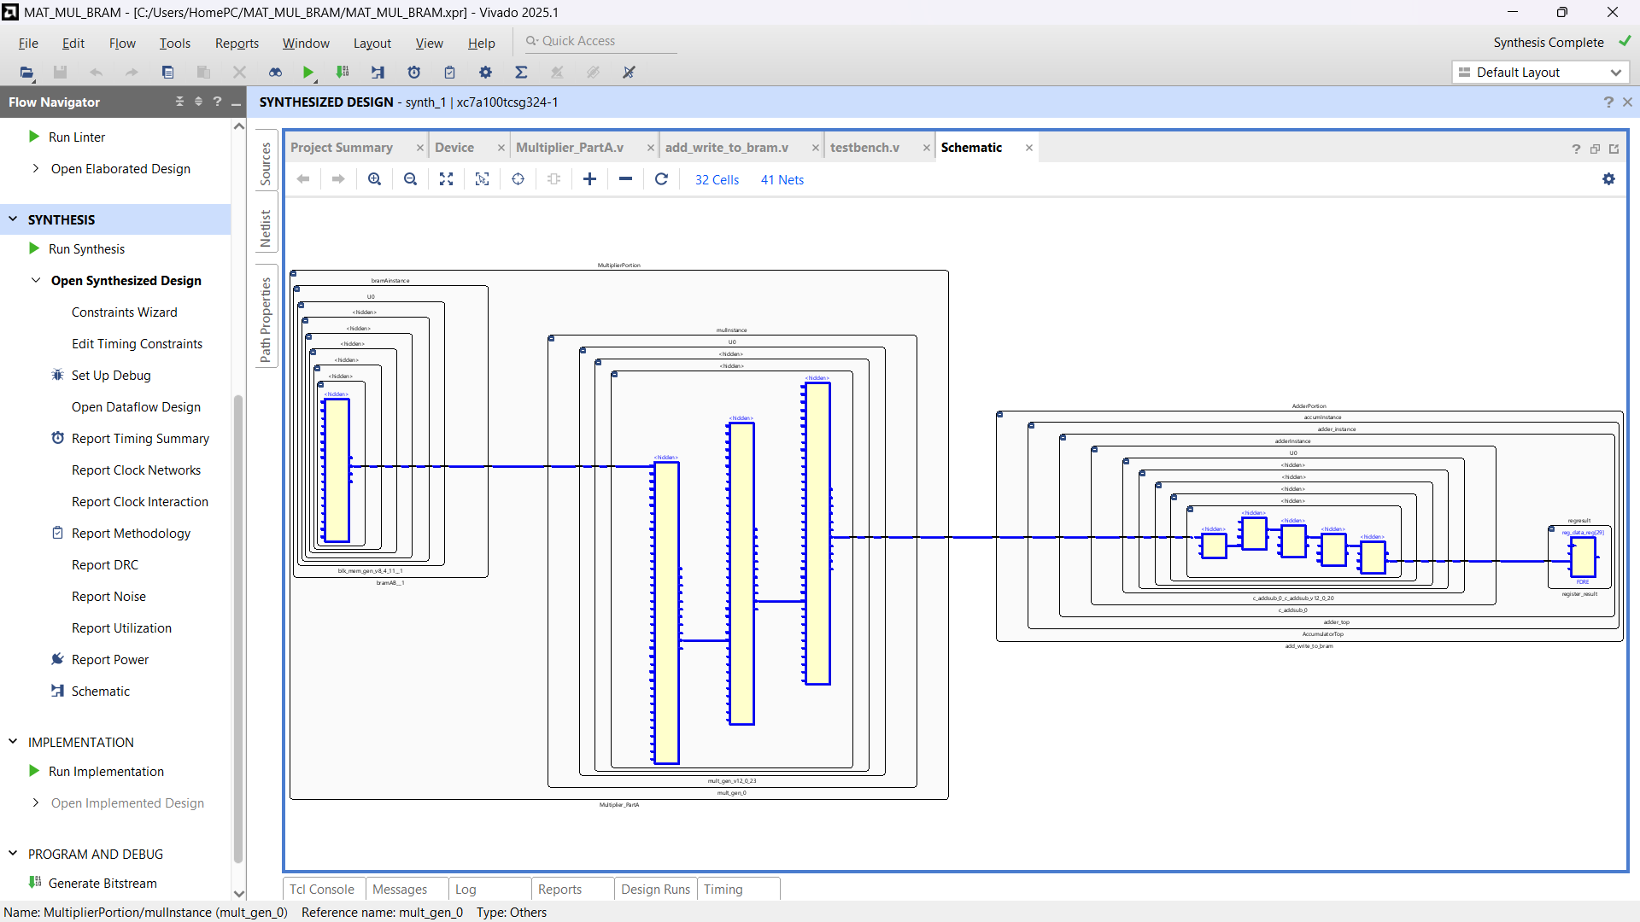

Slide 30
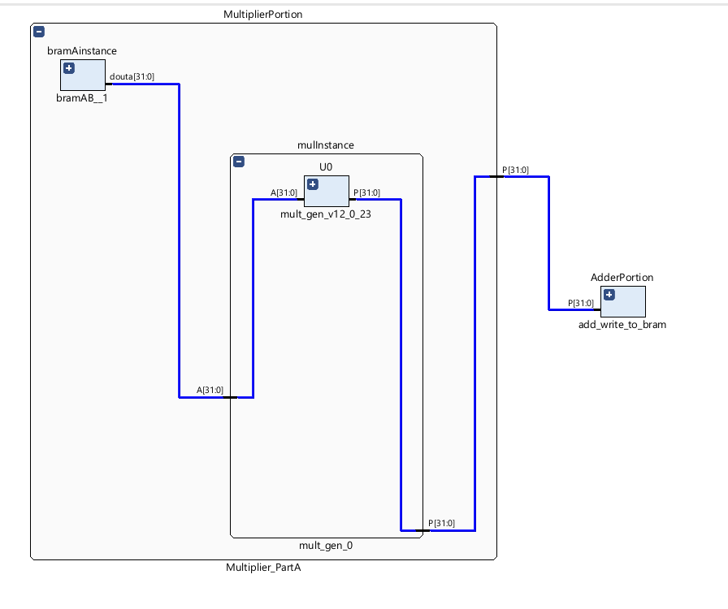
To explore more about the path just minimize them and zoom in The path is from bram going to the multiplier and then going to the adder inside which we have a register this is the trublsome path which is getting us WNS –VE

Slide 31
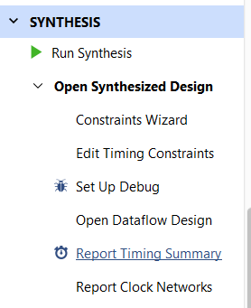
ONE solution this is increase the clock period by pressing on edit timing constraints

Slide 32
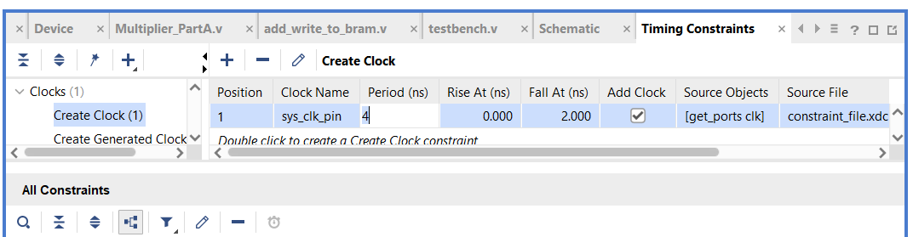
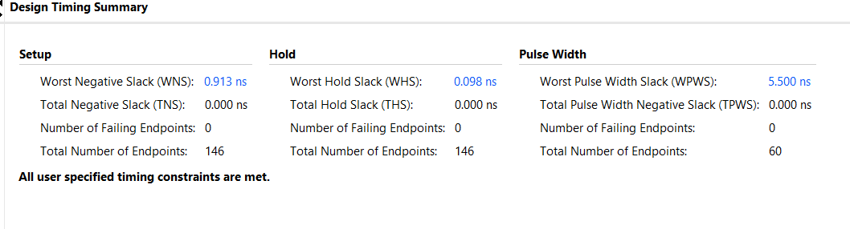
Now increase the clock period by 8ns as that’s what we got in WNS as -7.087ns make it 12ns and click on apply and rerun
Now the issue is solved as you can see there is no violation

Slide 33
But we don’t want to change the total time period our job is to keep it 10ns period or infact lesser than that so that’s where we use PIPELINED code comes now go back to the multiplier code go to the sources we have to change the multiplier instance

Slide 34
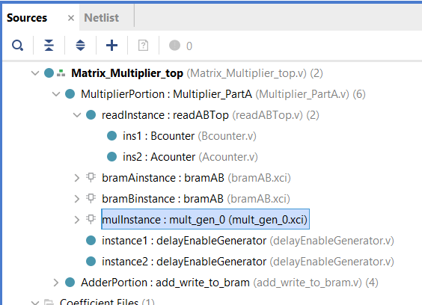
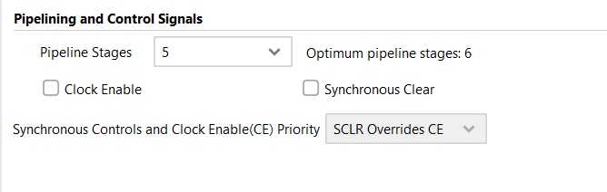
Double click on this make pipeline stages 5 and press ok and generate

Slide 35
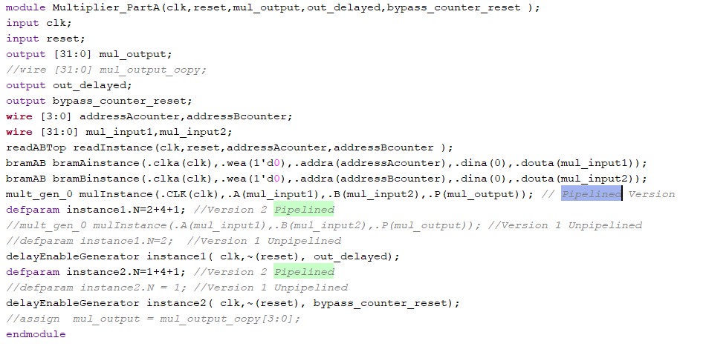
Having generating these files we need to change the code as well so in multiplier part A just uncomment all the pipeline version and comment all the unpipelined version of code and save it

Slide 36
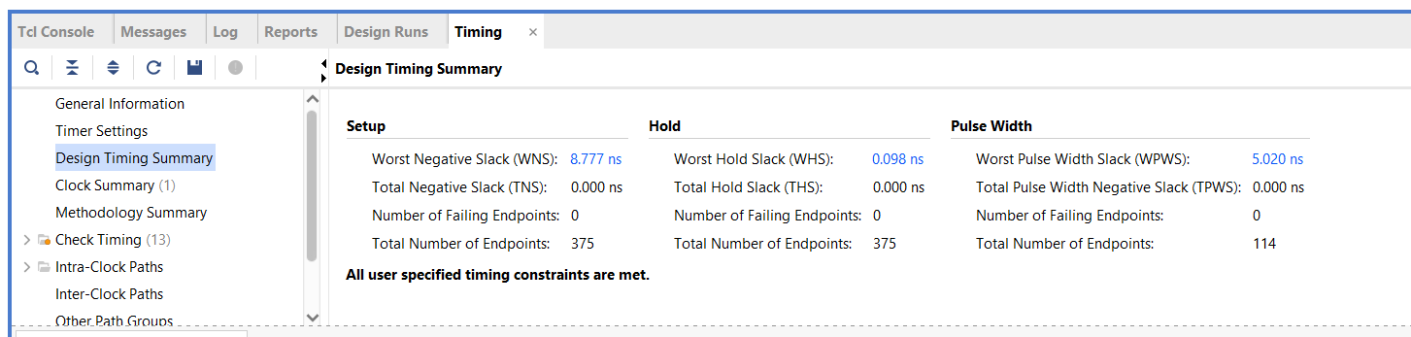
Now run simulation and check the functionality and then run synthesis and open the synthesized design check the timing response this time we don’t see the failure by this we can increase the clk frequency without any issue or reduce the clk period just press edit timing constraint

Slide 37
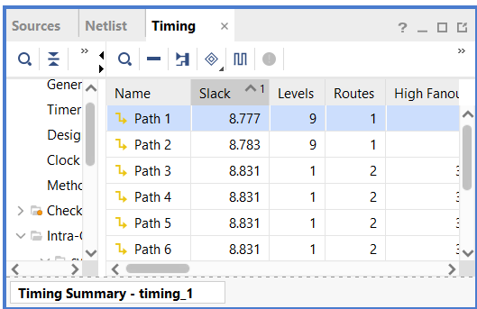
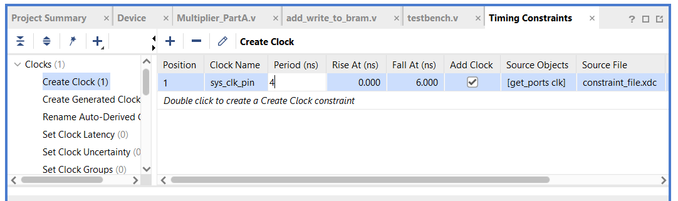
As the slack is 8ns we can decrease the period to 4ns now rerun and u will see 0.77ns by this we can see approx 3.77ns Is the best clk period we can get by only pipelining the multiplier

Slide 38
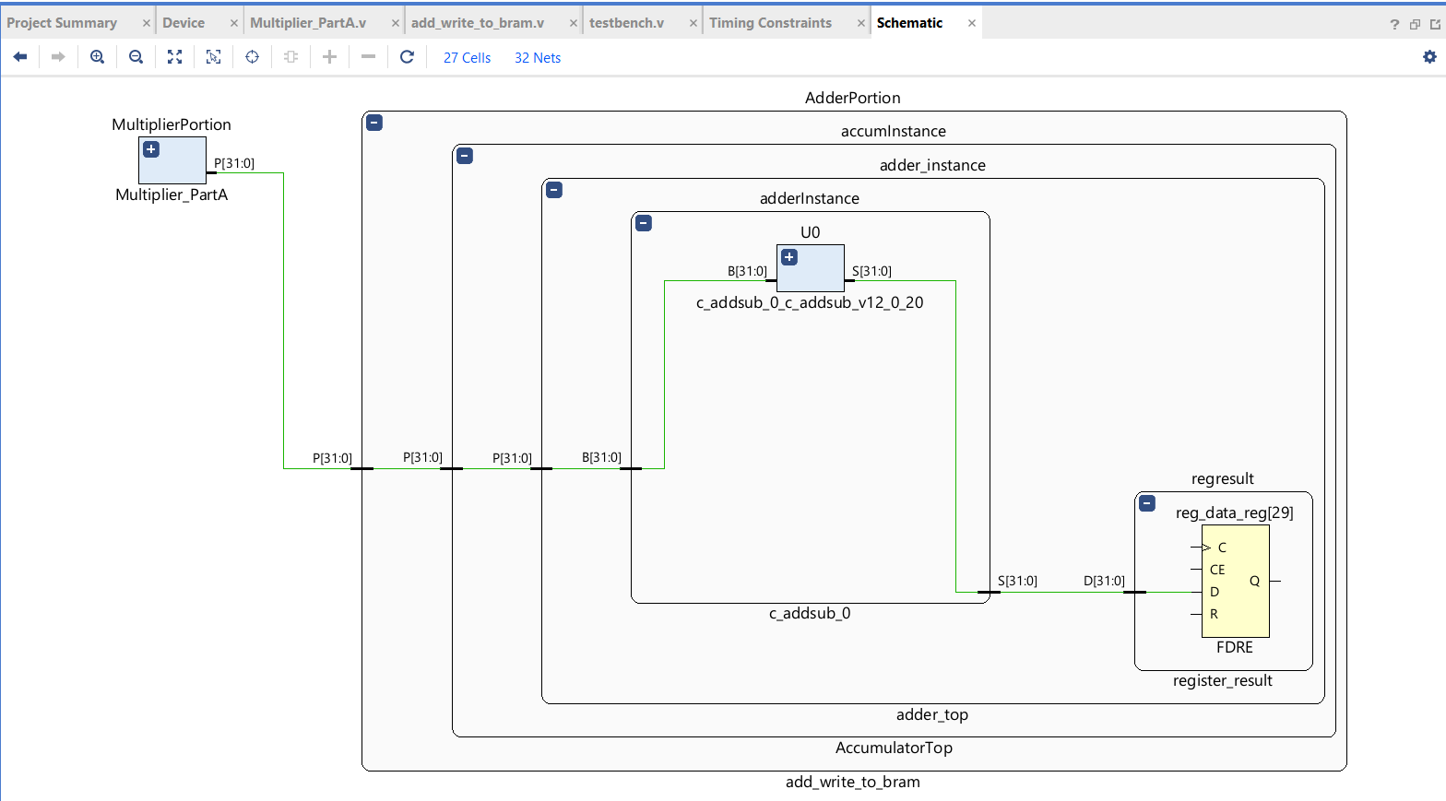
We can further improve this by identifying the critical path which is taking less time so press on the 0.77ns and then select a path and open the schematic

Slide 39
If you zoom in and minimize some blocks you will understand that entire 32 bit addition is been completed in the single cycle and then being written to the register THAT IS THE CRITICAL PATH

Slide 40
Now how do we improve further ? Just pipeline the adder also so, change the code accordingly to ensure that it works with this new pipeline which you guys can explore Now let us look into utilization report

Slide 41
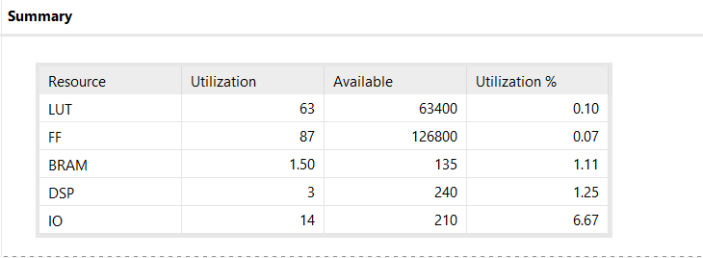
UTILIZATION REPORT

Slide 42
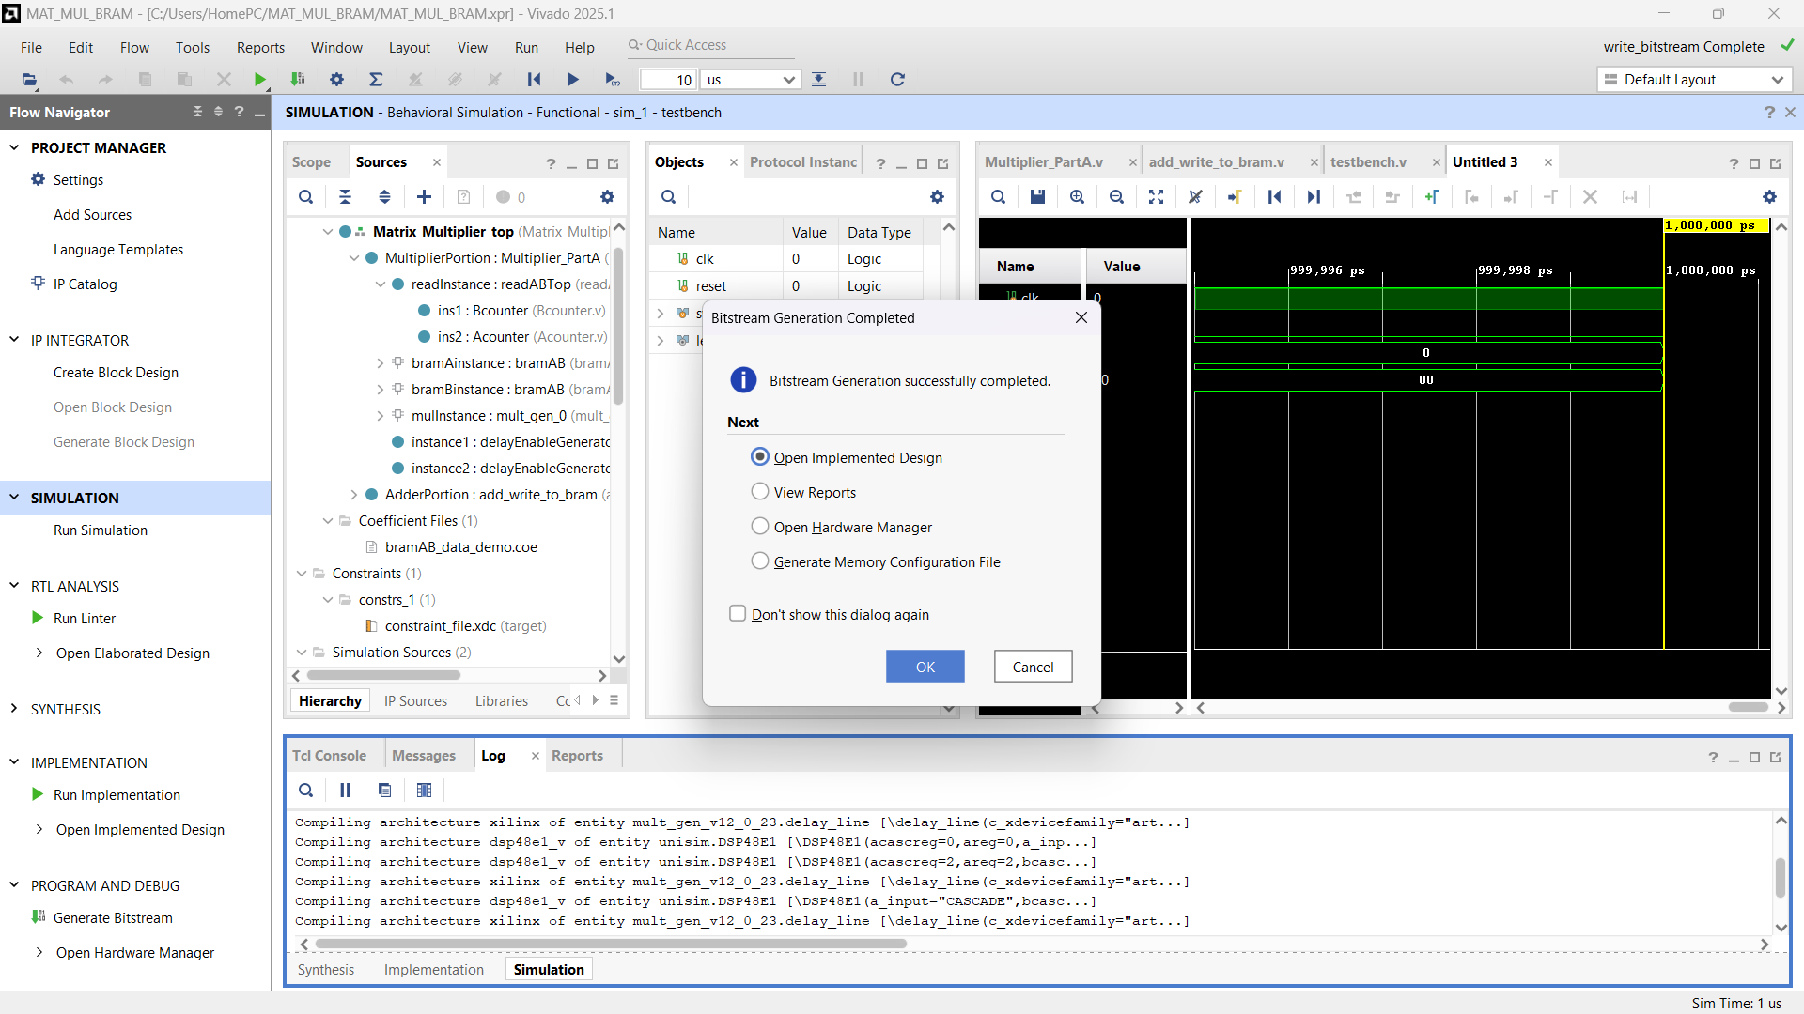
GENERATE BITSTREAM

Slide 43
NOW you can program it on FPGA and look at the board to see the output

